Slide 1
Computer Literacy CSC 1100
Lecture 2
Using Computers and File Management (With Windows OS)

Slide 2
Outline
Operating System
Starting and Manipulating Microsoft Windows
Working with the mouse
Closing Windows and shutting down the Computer.
Working with Menus
Working with Disks
Starting and closing a Program
Start menus and taskbar
Opening Multiple Programs
Creating documents
Creating Folders
Moving and Copying Documents and Folders
Renaming Documents and Folders
Deleting Documents and Folders
Understanding the Explorer
Using a printer

Slide 3
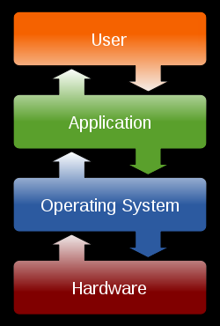
Operating System
It is a program/(system) software that controls the system’s hardware and interacts with the user and application software.
The operating system acts as an intermediary between application programs and the computer hardware.

Slide 4
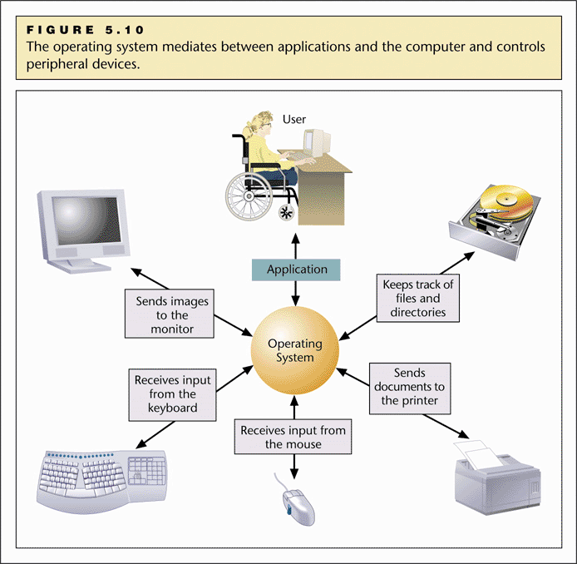
Operating Systems (O/S)

Slide 5
Functions of an operating system
It Provides a user interface. In other words displays the on-screen elements with which you interact.
Loads programs into the computer’s memory so that you can use them.
Coordinates how programs work with the computer’s hardware and other software.
Manages the way information is stored on and retrieved from disks.
Manages resource sharing.

Slide 6
Types of an operating system
Operating systems can be categorized according to availability, number of users, type of interface design and manufacturer:
According to availability
- Real-time operating systems
- Non-real-time operating Systems
According to number of users
- Single-User/Single-Tasking Operating Systems
- Single-User/Multi-Tasking Operating Systems
- Multi-User/Multitasking Operating Systems

Slide 7
Types of an operating system
According to interface design
- Command line interface
- Graphical user interface
According to manufacturer
- Microsoft Windows operating systems
- Linux
- Mac OS etc

Slide 8
Types of an operating system
Single-User/Single-Tasking Operating Systems:
Allows a single user to perform just one task at a time
Take up little space on disk
Run on inexpensive computers
Examples include; MS-DOS and Palm OS for palm handheld computers.
Single-User/Multi-Tasking Operating Systems:
Allows a single user to perform two or more functions at once.
Commonly used on personal computers.
Examples include; Microsoft Windows and MAC OS.

Slide 9

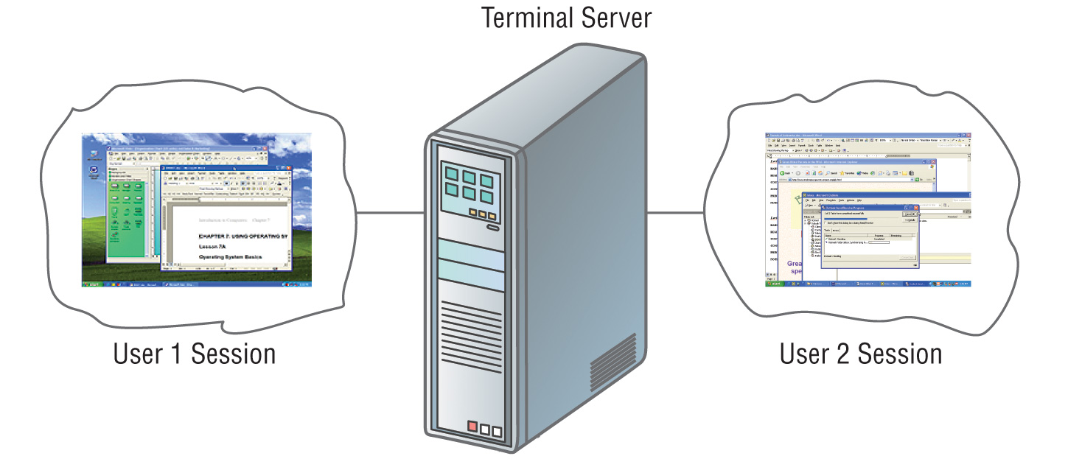
Multi-User/Multitasking Operating Systems:
Allows multiple users to use programs that are simultaneously running on a single network server.
Here, each user is given a user session on the server.
UNIX, Linux are examples.
Maintenance can be easy.
Requires a powerful computer.

Slide 10
Types of an operating system
Real-Time operating Systems:
- Very first, relatively small OS.
- Also referred to as embedded OSs
- Built into a circuitry of a device, not loaded from a disk drive
- RTOS is needed to run real-time applications.
- A real time application is an application that responds to certain inputs extremely quickly.
- As the name suggests, there is a deadline associated with tasks and a RTOS adheres to this deadline as missing a deadline can cause affects ranging from undesired to catastrophic.

Slide 11
Types of an operating system
The two most common types of user interfaces are graphical and command line.
Graphical user Interfaces (GUI):
Most common interface used in versions of;
Windows, MAC OS, in some versions of LINUX and UNIX.
Uses a mouse to work with graphical objects such as windows, menus, icons, buttons and other tools.
Can use Shortcuts to open programs or documents.
It enables task switching.
Advantage: It frees a computer user from memorizing and typing text commands.

Slide 12
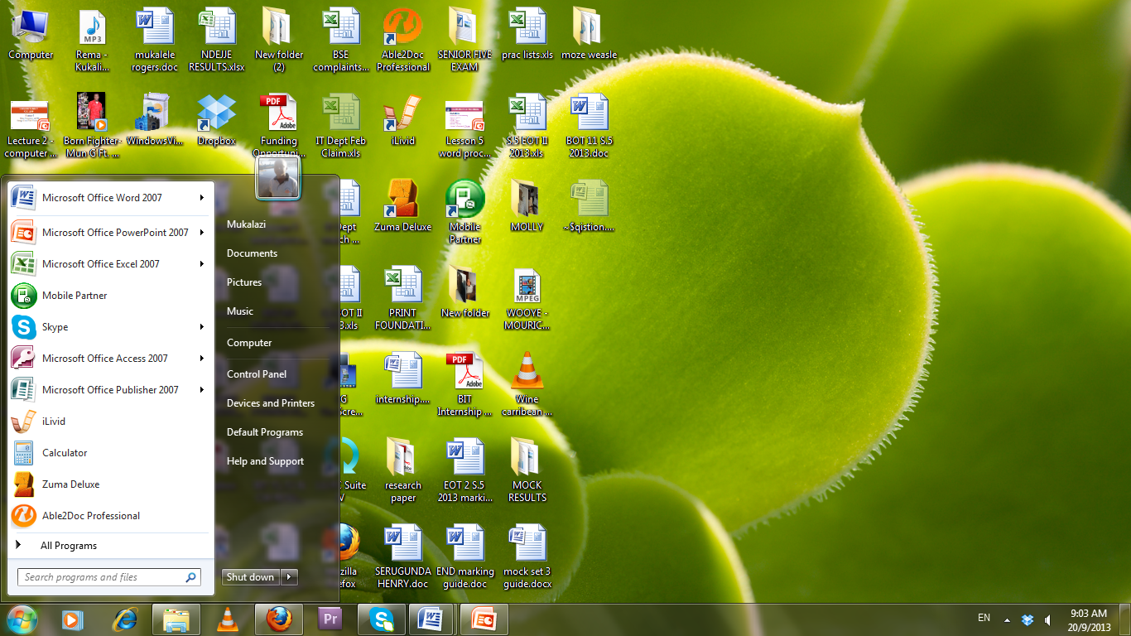
Graphical User Interface

Slide 13
The User Interface - GUI Tools
Icons are pictures that represent computer resources, such as printers, documents, and programs.
You double-click an icon to choose (activate) it, for instance, to launch a program.
The Windows operating system offers two unique tools, called the taskbar and Start button which help you run and manage programs.
A menu groups related commands. For example, the File menu's commands let you open, save, and print document files.
In programs designed for the same GUI, menus and commands are similar from one program to another.

Slide 14

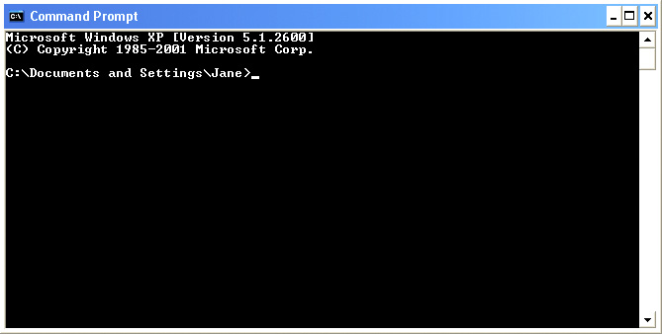
Command Line Interface
Older interface used in MS-DOS, Linux, UNIX
User types commands at a prompt to execute tasks.
User must remember all commands.
Windows also has an optional command prompt that can be used by administrators to run non-GUI programs for managing and troubleshooting windows.

Slide 15
Personal Computers Operating Systems
DOS(Disk Operating System)
It supports one user and one program at a time. In other words it is s a Single user, single-task OS
Uses a Command line interface
Supports only 16-bit programs yet most modern programs are either 32-bit or 64-bit.
Oldest operating system.
Advantages of using DOS:
It doesn't require much memory or storage space
Doesn’t require a powerful computer.

Slide 16
Personal Computers Operating Systems
Microsoft Windows:
Microsoft created the Windows operating system in the mid-1980s.
Earlier windows versions include windows 3.0, 3.1, windows 95, 98, 2000, windows NT and many more.
Most popular versions are Windows 7 (released in 2009), Windows Vista (2007), and Windows XP (2001).
It comes preloaded on most new PCs, which helps to make it the most popular operating system in the world
Mostly Graphical user Interface.
Latest windows versions have additional features such as; Digital Media support, Advanced Networking and Communications, Advanced Mobile Computing .

Slide 17
Personal Computers Operating Systems
Macintosh Operating System(Mac OS):
Used on Apple machines.
It comes preloaded on all new Macintosh computers, or Macs.
All of the recent versions are known as Mac OS X (pronounced Mac O-S Ten), and their specific version names are Lion (released in 2011), Snow Leopard (2009) and Leopard (2007).
Apple also offers a version called Mac OS X Server, which is designed to be run on servers.
Apple computers tend to be more expensive this is why Mac OS X users are very few compared to Windows users ( which are over 90%).

Slide 18
Personal Computers Operating Systems
Linux
It is a 32-bit/64-bit OS that supports multiple users and multiple processes at the same time.
It is a free or inexpensive version of UNIX.
It is very stable, fast and secure.
Mostly uses a command line interface but also has a GUI environment.
It is Open Source which means that it can be modified and distributed by anyone around the world.
The most popular Linux distributions include Ubuntu, Mint, and Fedora.

Slide 19
Windows Operating System Basics

Slide 20
Using a computer
Starting your computer
Check that it is plugged into the electricity socket, press the button to power it.
Some computers have a single button for both a computer and the screen others have two.
Powering up or booting
Is a technical term for starting up a computer and display windows desktop screen.
A Cursor
Is a symbol usually an arrow that you move around the computer screen by moving the mouse across your desktop.

Slide 21
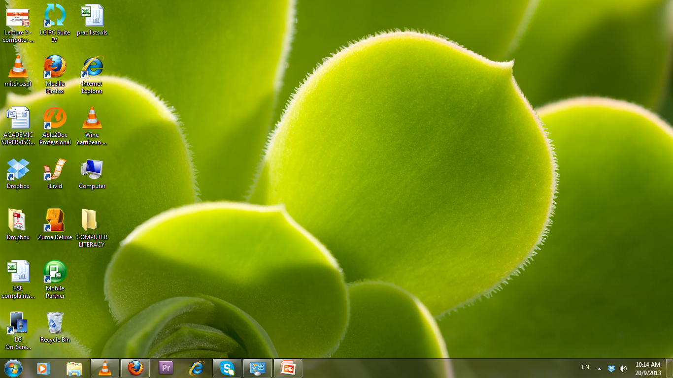
Appearance of a Windows desktop
Icons
Icons
Start button
Task bar
Task bar
Start button

Slide 22
Common terms
Clicking
Briefly holding down the left or the right mouse button.
By clicking on an item around a computer screen means you have selected it.
Left , right and double clicking give different functionalities.
Menu
A list of items displayed on a computer screen.
Taskbar
A horizontal bar across the bottom of the windows desktop that displays a start button plus the name of any open application.

Slide 23
Common terms
Multi-tasking
Ability of windows to have several applications and files open at the same time.
Buttons
Maximize
Button
Restore
Button
Minimize
button
Close
Button

Slide 24
Common terms
Command button
A button that performs or cancels an action e.g. OK and Cancel buttons.
Dragging with the mouse
Moving a selected item on the desktop by clicking on it with the left mouse button, and holding the button as you move the item.
Dialog box
A rectangular box that windows displays when it needs further information before it can carry out a command or when it needs to provide you with more information.

Slide 25
Common terms
Drop-down list box
Is a list of options that you can select from.
Option buttons
A group of round buttons indicating alternative choices.
Check boxes
A set of square boxes that you can select or clear to turn options on or off .

Slide 26
Working with the Control Panel
The Control Panel is a part of the Microsoft Windows GUI which allows users to view and manipulate basic system settings such as adding hardware, adding and removing software, controlling user accounts, and changing accessibility options.
The control panel helps the computer user to change settings and customize the functionality of your computer.
To access the control panel: Click on the Start button- then click on Control panel in the menu items provided.

Slide 27
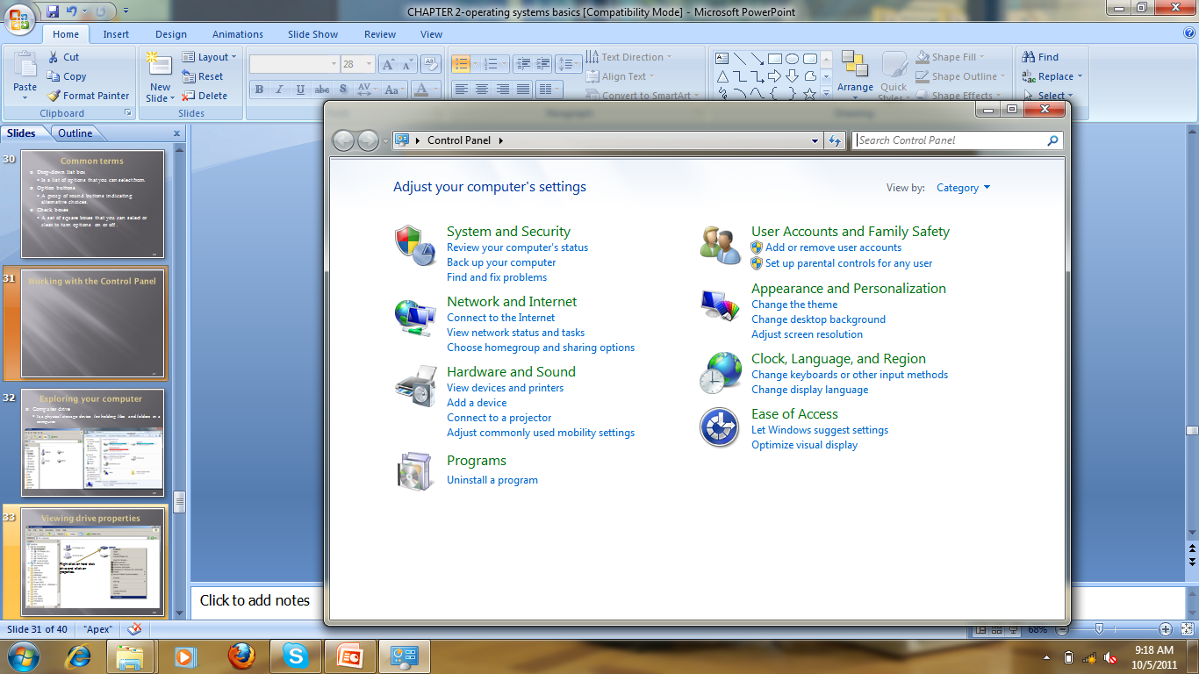
Working with the Control Panel

Slide 28
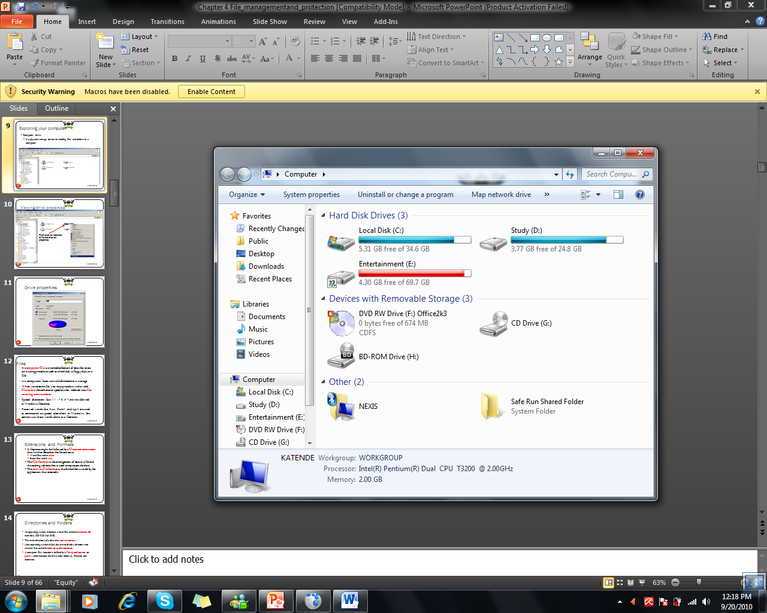
Exploring your computer
Computer drive
Is a physical storage device for holding files and folders in a computer.

Slide 29
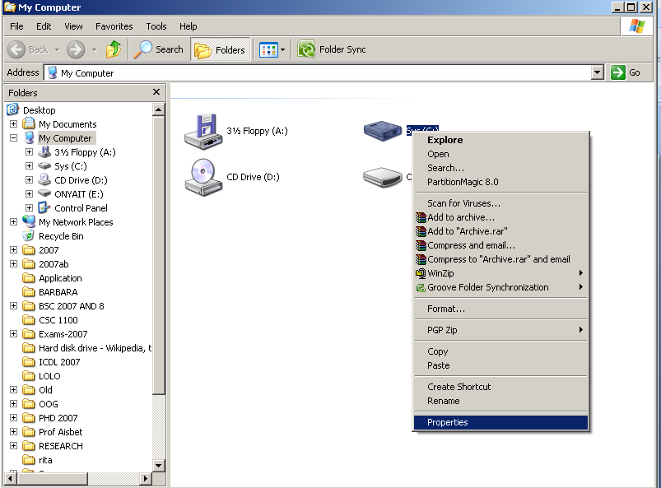
Viewing drive properties
Right click on hard disk drive and click on properties.

Slide 30
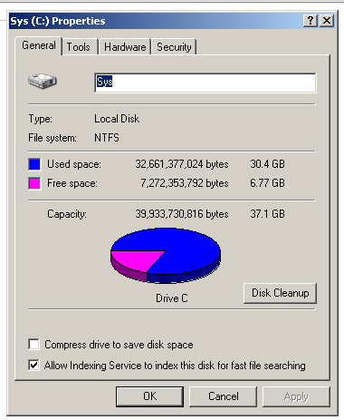
Drive properties

Slide 31
File Naming Conventions
A computer file is a named collection of data that exists on a storage medium such as a hard disk, a floppy disk, or a CD.
Is a computers’ basic unit of information in a storage.
When you create a file, you must provide it with a valid filename that adheres to specific rules, referred to as file naming conventions.
Special characters like / \ : ? < > * are not allowed in Windows filenames.
Reserved words like Aux, Com1, and Lpt1 are used as commands or special identifiers in Windows. You cannot use these words alone as a filename.

Slide 32
Directories and Folders
An operating system maintains a list of files called a directory for each disk, CD-ROM or DVD.
The main directory of a disk is its root directory.
Most operating systems allow the user to divide a directory into smaller lists called folders or subdirectories.
A computer file’s location is defined by a file specification (or path) which includes the drive letter, folder(s), filename, and extension.

Slide 33
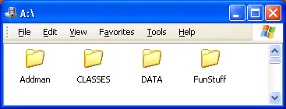
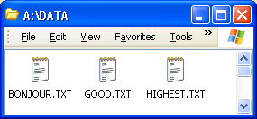
Example File Specification
A:\DATA\GOOD.TXT
A: is the Drive Letter
DATA is the folder name
GOOD is the filename
.TXT is the filename extension

Slide 34
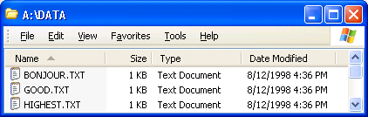
File Sizes and Dates
File size is usually measured in bytes, kilobytes or megabytes.
The file date is the date the file was created or last modified.

Slide 35
File Management
Folders are the best way to organize and store your data on your computer. Folders located inside other folders are often called subfolders. Steps of creating a folder in windows.
Go to the location (either a folder or the desktop) where you want to create a new folder.
Right-click a blank area on the desktop or in the folder window, point to New, and then click Folder.
Type a name for the new folder, and then press ENTER.

Slide 36
Moving/copying Files
To move files, first highlight the files and then choose Edit, Cut from the menu, and Edit, Paste in the menu of the target window.
Files can also be moved and copied by dragging.
Place the mouse pointer on a highlighted file and move it while holding down the left mouse button.
Release button at the target point.

Slide 37
Deleting Files
When you delete a file, the operating system changes the status of the file’s clusters to empty and removes the filename from the FAT.
To delete data from a disk in such a way that no one can ever read it, you can use special file shredder software that overwrites empty sectors with random 1s and 0s.
The Windows Recycle Bin is designed to protect you for accidentally deleting hard disk files that you actually need.

Slide 38
Questions
What are the differences between the command line and GUI interfaces?
What is a non-real-time OS?
What are the characteristics of a non-real-time OS?
Where can a non-real-time OS be applied?
Critically, discuss the following features of a Windows Desktop:
Start Button
Taskbar
System tray

Slide 39
Questions cont …..
State the steps that you have to follow to create a folder with three subfolders on the desktop?
Name and explain the four mouse operations
What is a water mark? What steps would you follow to insert watermark in a word document?
What is the difference between the following types of document views: draft view and outline view?
List any two examples of word processing Applications

